Slide 1

NYSE PRICES ASSESSMENT
Analytics assessment for business intelligence developer

Slide 2






Process Workflow
Data Collection
ETL
Modeling / Analytics
Reporting
Data collection from defined sources
Data loading, transformation and cleaning using MS SSIS
Data inspection, transformation through Sql Server, and modeling using Qlik Modeler
Development of Dashboard Reporting on QlikView Personal Edition

Slide 3
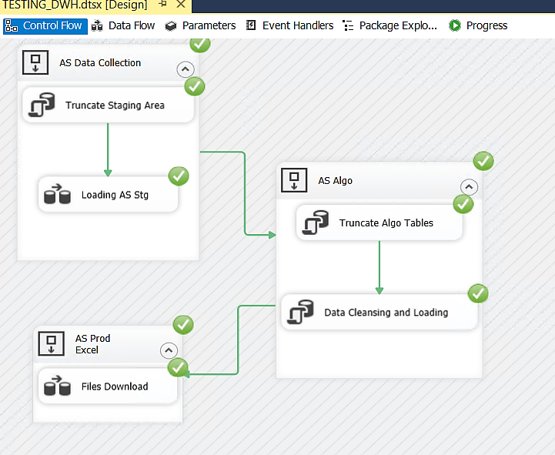
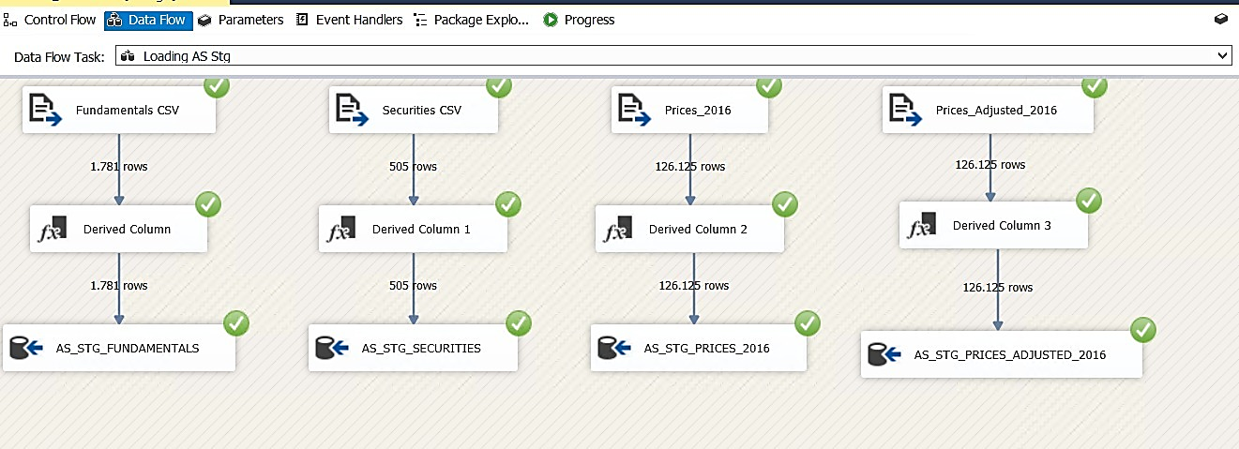
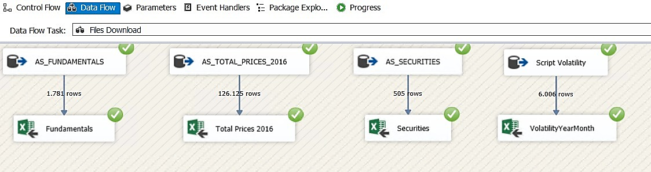

Data collection and ETL
It has been created an ETL process on SSIS that develops in the following phases
Uploading CSV files to staging tables
*
Execution of Sql scripts for data cleansing, transformation and modeling through preliminary Sql joins ( * Attached Script)
Creation of semi-elaborated files in .xlsx format

Slide 4
Data Transformation Process: Best Practice
The different Datasources have been processed through scripting SQL Server, below the steps:
Identification of Keys by running script tests on loaded staging tables
Fundamentals: [Ticker Symbol], [Period Ending]
Securities: [Ticker Symbol]
Prices_2016: [Ticker Symbol], [Date]
Price_Adjusted_2016: [Ticker Symbol], [Date]
Data cleansing by using default and custom functions, to identify any case of non-Ascii or inconsistent characters with the nature of the information.
Standard fields Formatting:
String Fields: Varchar(50) (usually better Varchar255, but since the work is in memory is better not to weigh it down)
Numeric Fields: Decimal(18,2) (Usually it is better to use 5 decimals for calculation purposes but since the process uses Excel, with two decimal values you get a tidier result when checking the data on file)
In order to make the Analytics/Dashboarding part more performant, the two CSV "Prices_2016" and "Prices_Adjusted_2016" have been merged into a single table using a Left Join.
The process has been automated in order to be relaunched and be able to load any future updates, the loading mode chosen is: FULL. In the future, by assessing the performance KPIs it can be evaluated to change the loading to Delta with Upsert Mode or Delete + Insert.

Slide 5
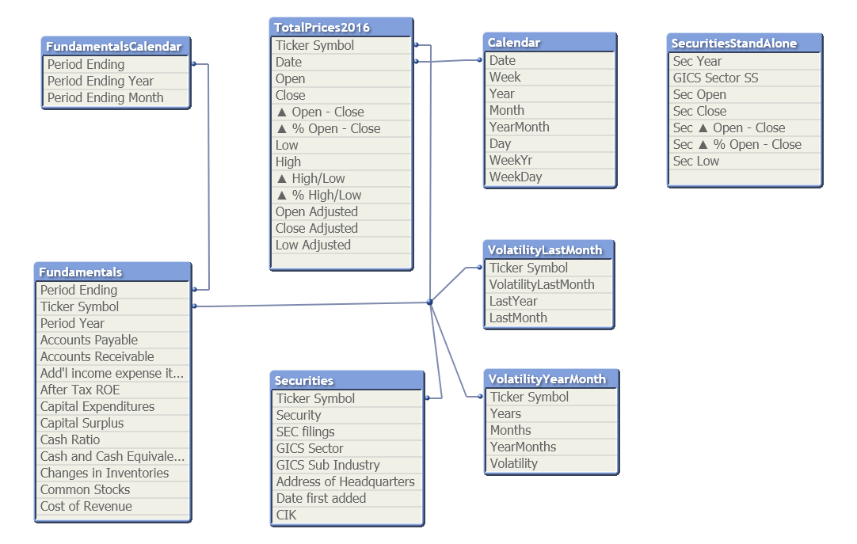
Qlik Embedded Model
Uploading files .xlsx for In-Memory processing.
Creation of the Main Calendar for Stock Prices and second calendar for the Fundamentals analysis, to avoid loops since QlikView joins are not application type (MS SSAS) and context creation is not possible (Sap BO)
Creation of Stand-Alone tables for single analysis, independent of logical-temporal relations
Creation of KPIs measures to propose to stakeholders, for analysis of the data displayed

Slide 6
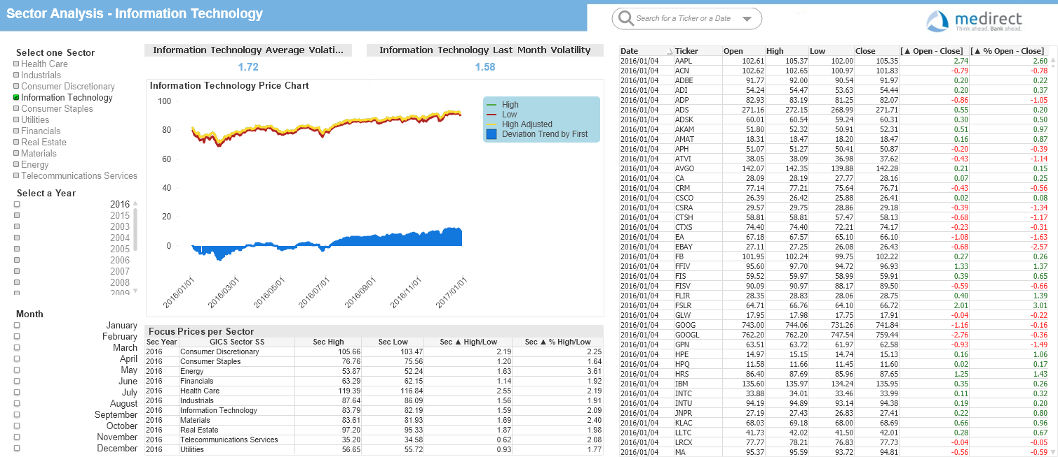
Data Visualization: Sector Analysis
The reports are structured on a logic of Macro to Micro analysis, let's assume that a customer wants to stabilize his portfolio and is looking for an investment stock with a smooth trend.
In the first report there is a general view of the market trend divided by sector, in this way the investor will have high-level visibility on the trend of the several sectors, from average prices to average volatility. In this way he will be able to evaluate from which sector begins his research.

Slide 7
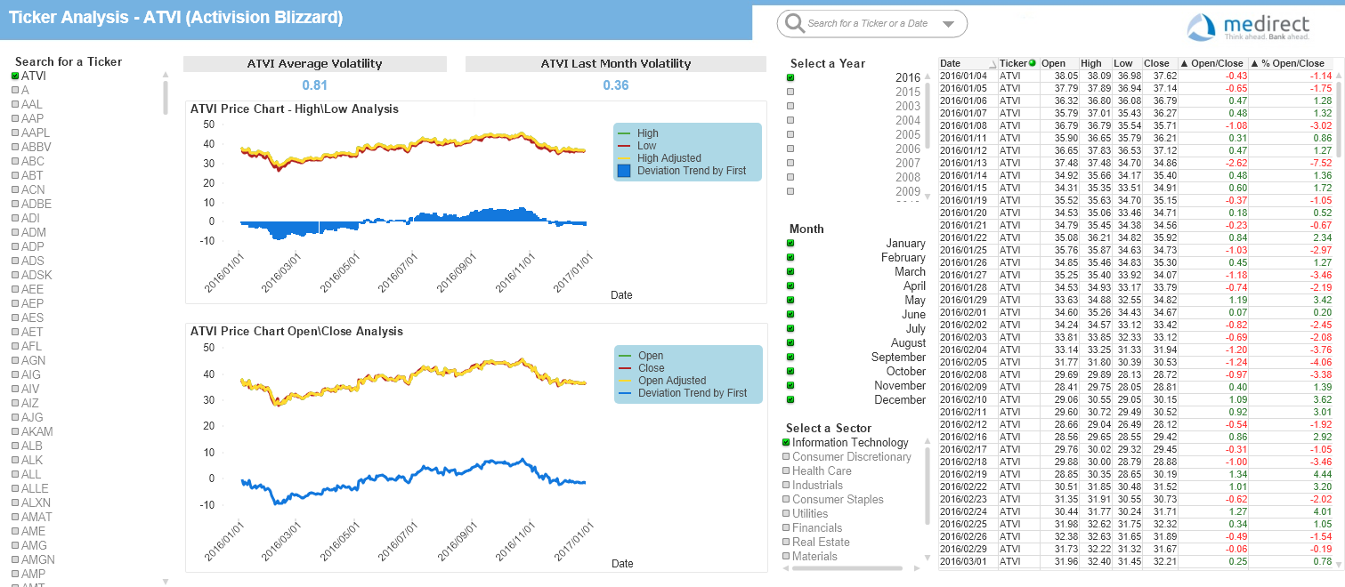
Data Visualization: Ticker Analysis
Once the market has been selected, it will be possible to access the list of shares, and check for each operation the annual trend and the price deviation from the first to the last day of the year, verifying that volatility is low and prices stable

Slide 8
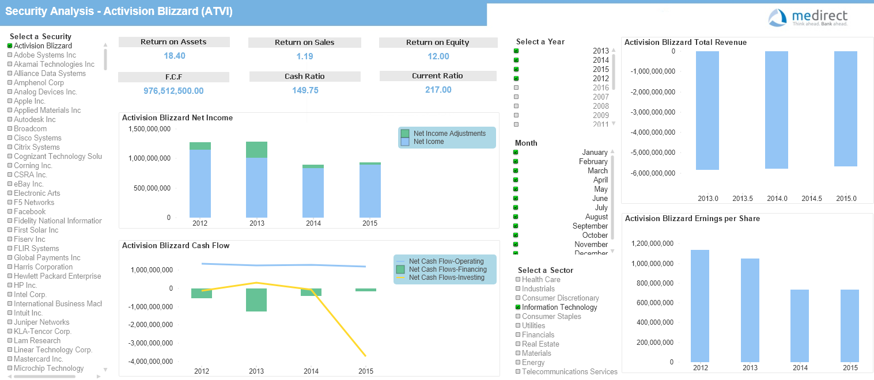
Data Visualization: Fundamentals Analysis
As a final analysis, the solidity of the company in which to invest will be verified from an economic-financial point of view, by analyzing the various KPIs available and the company's performance over the last 4 years

Slide 9
Conclusion and improvement suggestions
Below are some conclusions and improvement suggestions on the reports:
Discussion with stakeholders about the quality of the data in order to report any incorrect algorithms and calculations. The B.I. team offers to provide along with the reports also an Excel pivot model (with the processed and cleaned data) where stakeholders can verify the data and/or provide any suggestions about missing KPIs and possible algorithms to be implemented.
Discussion about aspects of report structure such as filters, for example the "Slider" to filter the date has not been used in any report as it is inconvenient and impractical on this version of QlikView.
Evaluate any data enrichment such as new dimensions or new measures.

Slide 10
For any question, please write to: mustafa.benkai@gmail.com

